Slide 1
Bal Gokulam
Lesson 6
June 2, 2012

Slide 2
Review
We will review topics from last week’s lessons on the physical features of Hinduism in our homes.

Slide 3
Question 1
Why is it important to have a clean home in Hinduism?
Cleanliness is next to
GODLINESS

Slide 4
Review Cont’d
Why do we have a prayer room/puja room in our homes?
Name some things that we might see in our puja room?

Slide 5
Review Cont’d
What symbol is this?

Slide 6
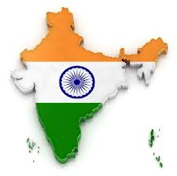

Slide 7
Review Cont’d
What are some hindu festival we celebrate?
Name some of the different ways we celebrate these festivals in our homes?

Slide 8
Today’s Lesson
What does a Hindu Home Look Like? (Part 2)
Behaviorial Characteristics
Things we do

Slide 9
Respect for parents and elders
Show respect to your parents and elders in deed and in words. If you have to disagree with them, do so in a way that is not hurtful or offensive.
Remind yourself that your parent will never intentionally do or ask you do anything that would be detrimental to you.
Also be reverential to your forefathers.

Slide 10
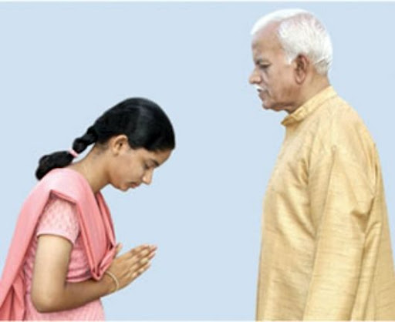
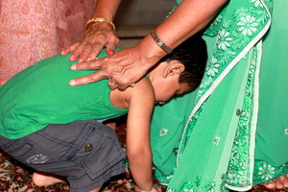

Slide 11
Doing things together
Doing things together truly bonds the family, and develops mutual understanding, love, and confidence among the family members.
Consider doing a collective evening prayer and Arti, having at least one meal together everyday, etc.
Once a week, sit down together to discuss rituals, traditions, or just tell stories.
What are some other things that you can do with your family?

Slide 12
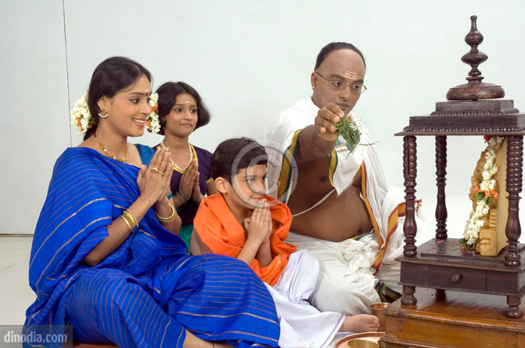
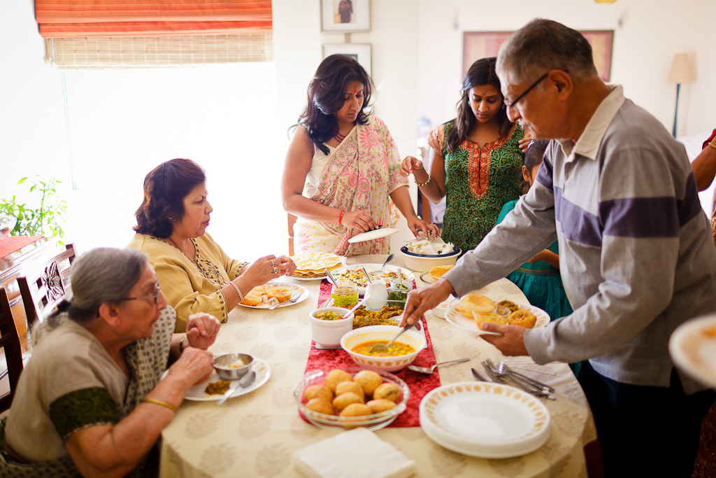

Slide 13
Getting up early
Early morning is called ‘Brahma Muhurt’ by Hindus and is considered a very auspicious time to do things.
Modern science has also confirmed the varied benefits of getting up early (and consequently going to bed early) – both physically and emotionally.
In practical terms, you will realize that you can get a lot more accomplished when your body and mind are rested and alert.

Slide 14
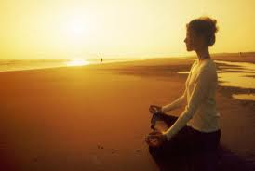

Slide 15
AvoidingWaste
There’s a Hindu saying: “Mother Earth has enough to provide us with all our needs, but not all our greed”
Be very mindful of what is consumed, and what is wasted.
Water, food, all forms of energy, paper, etc are all precious resources that we should conserve as much as possible.
By extension, try to avoid buying things on impulse; buy only what you have identified as truly needed after considerable thought.
Avoid an ostentatious lifestyle – live frugally and learn to enjoy the pleasure in giving.

Slide 16
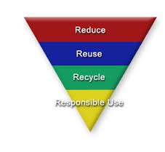

Slide 17
Being a Role Model
Practice the above, educate yourself on Hinduism, and resolve to be socially active.
Try to do everything to the best of your ability.
These will make you a role model for others to emulate. To create such individuals is the goal of an Ideal Hindu Home

