Slide 1
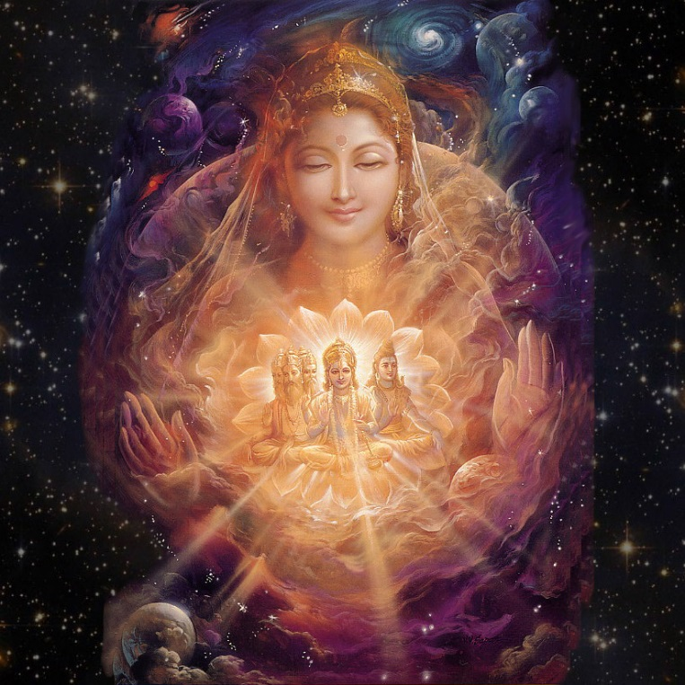
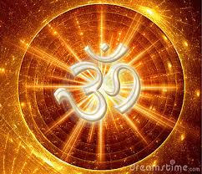
AdiShakti
The goddess AdiShakti, in Hindu Dharma represents supreme cosmic energy which exists from the beginning of the universe. It also referred as ‘the great divine mother’ in Hinduism

Slide 2
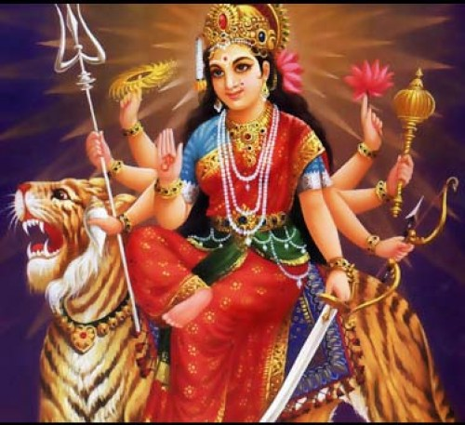
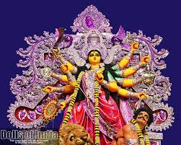
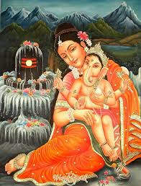
AdiShakti Incarnations
The complete incarnation of the Goddess of power. She has three chief manifestations: Durga, Goddess of strength and valour, MahaKali, Goddess of destruction of evil and Goddess Gowri, the Goddess of benevolence.

Slide 3
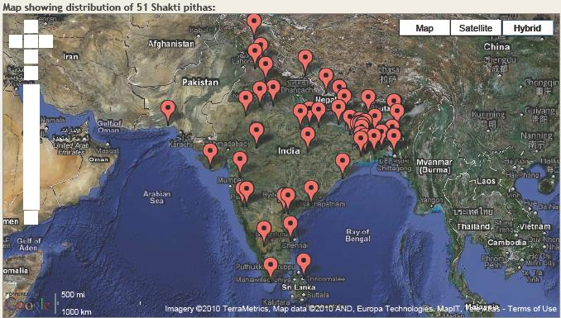
Shakti Peethas
The Shakti Peethas (Sanskrit: शक्ति पीठ, Śakti Pīṭha, seat of Shakti) are places of worship dedicated to the goddess Shakti, the female principal of Hinduism and the main deity of the Shakta sect. They are 18 MahaShakti Peetas and 51 Shakti Peetas sprinkled throughout the India which is culturally unifying force of Bharat.

Slide 4
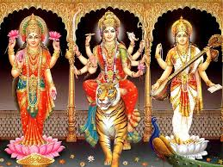
Tri-Devi
Along with TriMurthy(personified in the form of Bramha, Vishnu, Shiva); Hinduism has unique concept of TriDevi (three main female forms of God ) that are personified by the forms of Hindu Goddesses: Saraswati, Lakshmi and Parvati. They all are the manifestations of the AdiShakti, (Divine Mother).

Slide 5
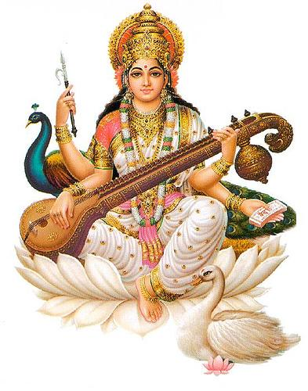
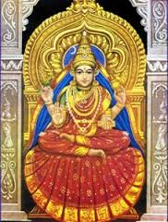
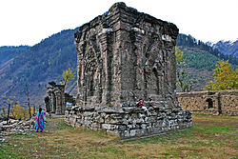
Saraswati Ma
Sharada Peeth (Sarvajnapeetha) temple ruins, in Kashmir
(“Namaste Sharda Devi Kashmira Puravasini Tvamaham Prarthaye Devi Vidya DanaCha De-hi-me
Veena Vadini, Hamsa Vahini
Kala Swamini Ma Saraswati
Sringeri Sharadamaba
Sringeri Mandir
started by Adi Shankara
Saraswati the goddess of learning and arts, cultural fulfillment (consort of Brahmā the creator). She is the cosmic intelligence, cosmic consciousness, cosmic knowledge.

Slide 6
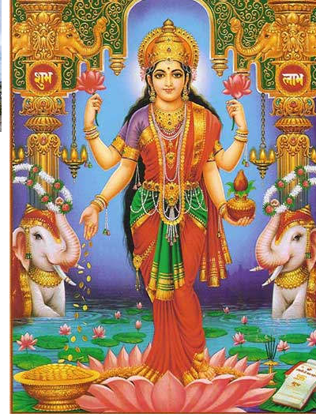
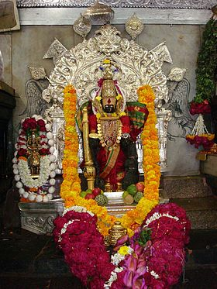
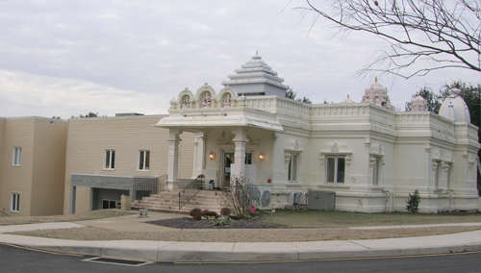
Laxmi Ma
Maha Laxmi Temple
In Delaware, USA
Namastestu Mahaa-Maaye Shri-Pite Sura-Pujite…
Mahaalakssmi Namostute
Mahalakshmi Temple,
Kolhapur, Maharastra
Lakshmi the goddess of wealth and fertility, material fulfillment (consort of Vishnu the maintainer or preserver). However, she does not mean mere material wealth like gold, cattle, etc. All kinds of prosperity, glory, magnificence, joy, exaltation, or greatness come under Lakshmi

Slide 7
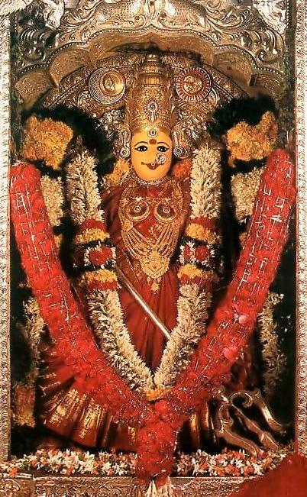
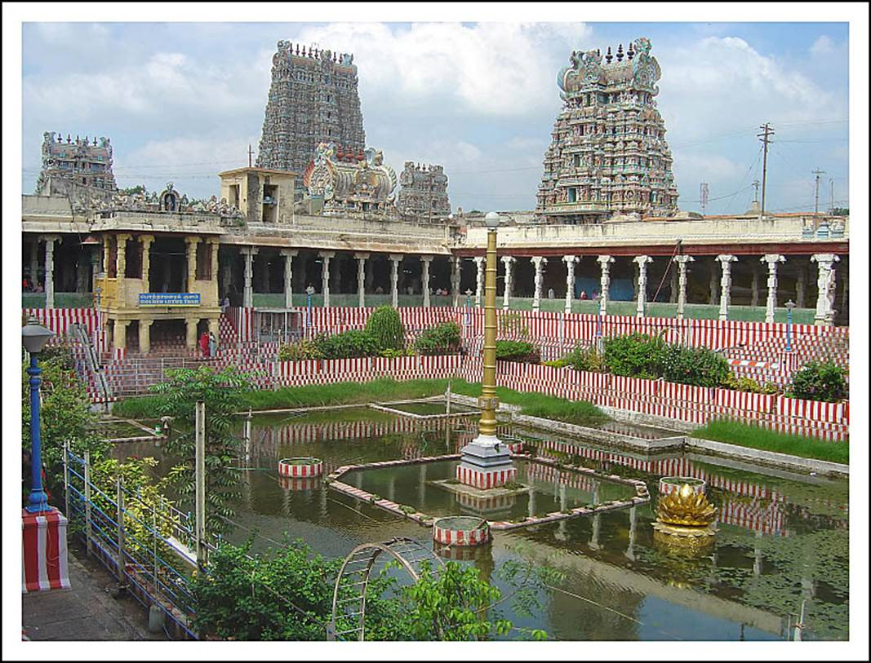
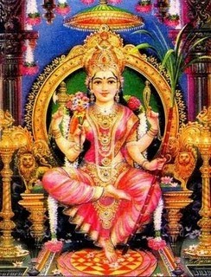
Parvati Ma / Maha Kali
Goddess Parvati
as Kanaka Durga
(Self manifested)
at Vijayawada, AP
Meenakshi(Parvati) Temple (in Madhurai,TN)
is an architecural marvel
aslo refered as ‘Athens of the East’
Sarva Mangala Maangalye,
Shive Sarvaartha Saadhike
Parvati/MahaKali (or in her demon-fighting aspect AdiShakti) the goddess of power and love, spiritual fulfillment (consort of Shiva the one who causes transformation or dissolution). She also depicts transformative power of Divinity, the power that dissolves all things into basic elements.

