Slide 1
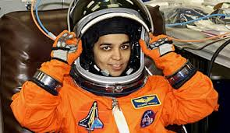
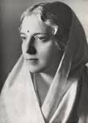
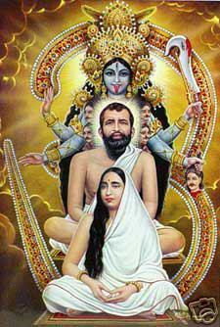
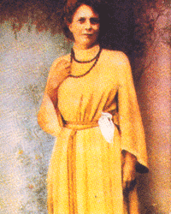
s
The power of women

Slide 2
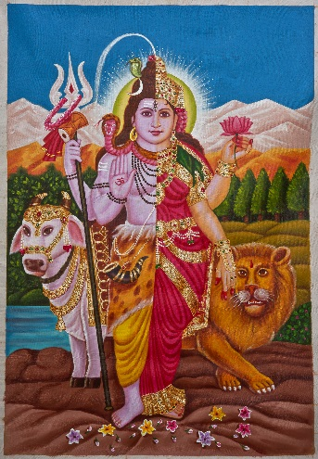
Introduction To Shakthi
Shakthi is power. This power is usually associated with women because Goddess Durga is called shakthi. Without Shakthi no one has power. One example is Lord Shiva. He cannot exist without Parvati so he is called Ardhanareeshwara.
The concept of worshipping shakthi is followed only in Hinduism. There are 51 shakthi peetas or places of shakhti worship in India.

Slide 3
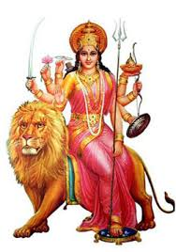
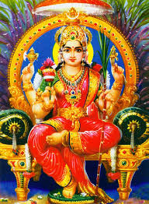
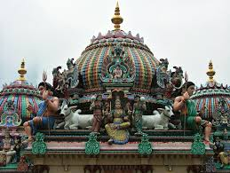
Importance of Shakthi
Shakthi is very important throughout India, especially in the rural areas. In the rural parts of south India, shakthi is referred to as Amman. In these parts of India, Amman is given great importance. People believe that she protects their villages, cures diseases, punishes evil doers and gives welfare to the villages. In the other parts of India there are many temples to the many forms of shakthi.
Durga
Rajarajeshwari

Slide 4
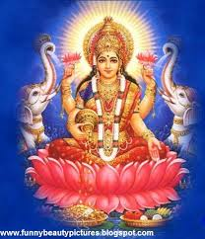
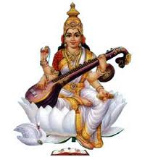
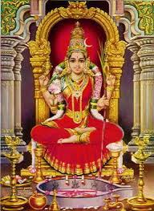
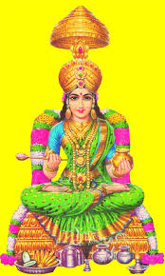
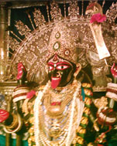
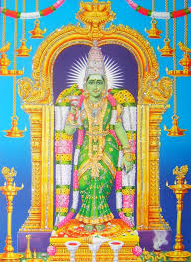
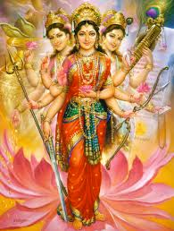
The Different Forms of Shakthi
There are many different forms of shakthi:
Durga
Lakshmi
Saraswathi
Kamakshi
Annapoorna
Dakineshwari
Meenakshi
Parvati

Slide 5
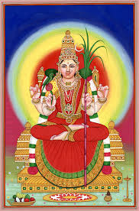
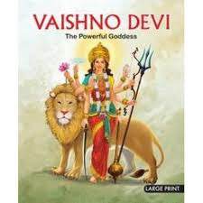
Rajarajeshwari
Vaishnodevi
Etc.

Slide 6
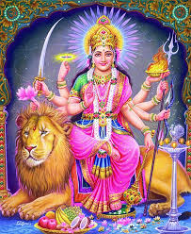
Forms of Shakthi in Detail
Durga (Ambaji In Gujarat, Chamundi Hills, Karnataka), many places…:
Durga is the Goddess of power or shakthi. she is a form of parvati with the power to destroy evil. She was created to destroy Mahishasura who was a rakshasa who was a threat to the people. She is usually seen riding a lion and wearing red.
Lakshmi (Kollapur maharastra, Tirupati, Andhra)many places:
Lakshmi is the Goddess of wealth and the wife of Vishnu. She came during the churning of the ocean. She is considered to be the daughter of a maharishi named Bhrigu. She is usually seen sitting on a pink lotus with money coming out of her hand

Slide 7
Saraswathi (Shringeri, Karnataka):
Saraswathi is the Goddess of Knowledge, education, and arts. She is the wife of brahma. She is usually seen wearing white clothes and sitting on a white lotus with a veena in her hand.
Meenakshi (Madurai, tamilnadu):
Meenakshi is the daughter of a pandya king. She was a warrior princess who married sundareshwara, an incarnation of Shiva. The meenakshi temple in Madurai is very famous throughout India.

Slide 8
Kamakshi (Kanchipuram, Tamilnadu):
Kamakshi is the only Goddess in Kanchipuram and is the wife of Ekambareshwara. She came to earth to destroy the evils in the society.
Annapoorna (Kashi, Uttarpradesh):
Annapoorna satisfies Shiva’s hunger by offering food to him. Therefore she is known as Annapoorna. She prevents her devotees from suffering from hunger. She is usually seen carrying a spoon with a long handle

Slide 9
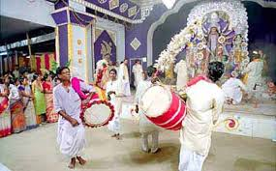
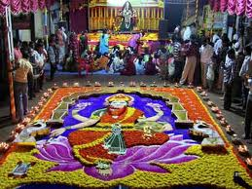
Celebration of Shakthi
Shakthi is celebrated throughout India in various different festivals. In the north, it is celebrated with these festivals:
Durga pooja
Santoshi maa pooja
vasant Panchami
Sharad poornimaa
In the south it is celebrated with these festivals:
Navarathri
Varalakshmi vratam
Savithri vratam
Saraswathi pooja

Slide 10
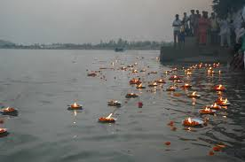
The Holy Rivers of India
Most of the Holy rivers of India are also named after female powers. These are their names:
Ganga
Yamuna
Kaveri
Saraswathi
Godavari
Narmada
Sindhu
Yamuna river
Kaveri river
Ganga river

Slide 11
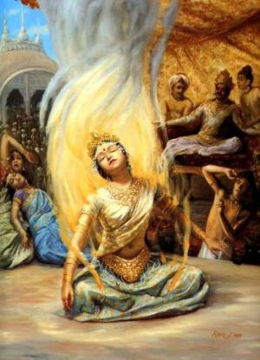
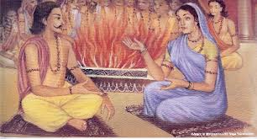
Great women of India
There are many great women in India who showed their power of shakthi. Some of these women are:
Gargi: is a an honored philosopher in ancient Sanskirt literature and the sacred teachings of the Upanishads. Gargi has its origin her gotra or community name, her real name is mentioned. In Vedic literature, she is honored as one of the great natural philosophers. Gargi makes her grand debut in the Brahmayajna debate that was organized to discuss spiritual scriptures in King Janaka’s court. The learned from Kuru and Panchala attended the debata. Janaka wanted to know who was the best knower of Brahman in the world at the time.
Maitreyi: Maitreyi was a Vedic philosopher from ancient India. She was the companion of famous sage and philosopher, Yajnavalkya. Maitreyi was well-versed in Vedas and associated scriptures and was called brahmavadini or "an expounder of the Veda" by people of her time. About ten hymns in Rig Veda are accredited to Maitreyi.
Gargi
Bramavadinis

Slide 12
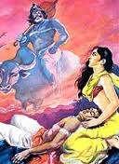
Savitri was the daughter of the king of Madra and the daughter-in-law of the exhiled and blind king of Shalva. Her husband was Satyavan and he had destined to die a year from when they were married. On the day of his death when Yama comes to collect Satyavan’s body, Savitri tried to stop him but she does not succeed. So she followed Yama and praised him until he gave her three boons. First she asks for her father-in-law’s eyesight and kingdom to be restored. Then she askes children for herself. Yama, after being tricked brings Satyavan back to life. She was another very smart and witty woman.

Slide 13
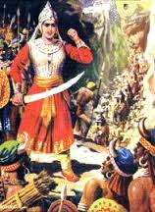
Women of Ancient India Who Were Incarnations of Shakthi
A few examples of women of ancient India who were an incarnation of shakthi were Rani Durgavati, Savitri, and Rani Chennamma. Rani Durgavati became the queen of the Gonds after her husbands death. She fough against the Mughal ruler Akbar when he tried to capture their kingdom. She mounted an elephant and fought bravely along with her soldiers, but because her army was smaller than the enemy’s and because the army was not very united they did not succeed. Still she has a very high rank among the brave women of India.

Slide 14
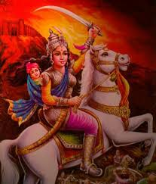
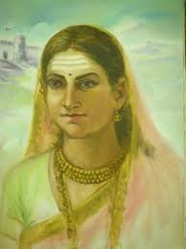
Rani Chennamma was the queen of Kittur. Her own son died so she adopted a son named Shivalingappa. The british opposed her so they tried to force her to surrender her kingdom but she was a strong woman who tried her best to not let the British take her kingdom away. She first tried peaceful methods like reasoning with the British but when that didn’t work, war broke out. She fought bravely till her last breath
Rani Lakshmi Bhai: she is the most famous freedom fighter. She fought for freedom from the British in the revolt of 1857.

Slide 15
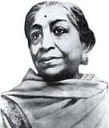
Great women of India
There are many great women in India who showed their power of shakthi. Some of these women are:
1. Nivedita : Born in Ireland, Miss Margaret Noble belonged to a family of Irish freedom fighters. A school teacher by profession, she became disciple of Swami Vivekananda at the 1893 Parliament of the World's Religions at Chicago and Became Nivedita. She came to India 1898 to serve Bharat Mata. She inspired youths throughout India and gave her rousing call to them to fight for freedom. She continued inspire Bharat’s nationalistic movements with the blessings of Vivekananda. With the blessings of Mother Sarada Devi, opened her school for girls in Calcutta in 1898. Till her last breath she dedicated her life service of poor children and helping India to get its freedom.
2. Sarojini Naidu: she was elected as the first woman president of the Indian National Congress
Nivedita
Sarojini Naidu

Slide 16
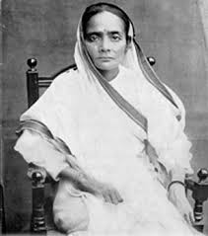
6. Kasturbha Gandhi: She was Mahatma Gandhi’s wife and supported him the whole way. She supported women’s education and creating awarenss regarding cleanliness of the environment we live.
7. Vijayalakshmi Pandit: She was elected as the first woman president of the United Nations General Assembly
8. Kalpana Chawla: she was the first Indian-American astronaut. She Worked in NASA as a reasercher. On February 1st , 2003, after completing her mission in outer space she was descending to earth when she died in a tragic accident along with the other astronauts in the spacecraft.
Kasturbha Gandhi
Vijayalakshmi Pandit
Kalpana Chawla

Slide 17
Conclusion
These slides helps to learn about Shakthi which Hinduism recognized as form of universal power, find reasons for worshipping it.
This helps understand the importance of respecting the power of women.
We can study the culture and history of different places in world and see how prosperous and progressive status of the society is linked to how well Shakti in women form is recognized and respected.

Slide 18
THE END

